Slide 1

TMS – Database Group
Haotian Xue
Yujia Huang
Chen Xu

Slide 2




Relationship
Trace Link Ontology
Import trace link ontology
Provide information & relationship
RDF file → database records
Data Visualization
Provide information
Collect & Restore input data
Database
Website

Slide 3
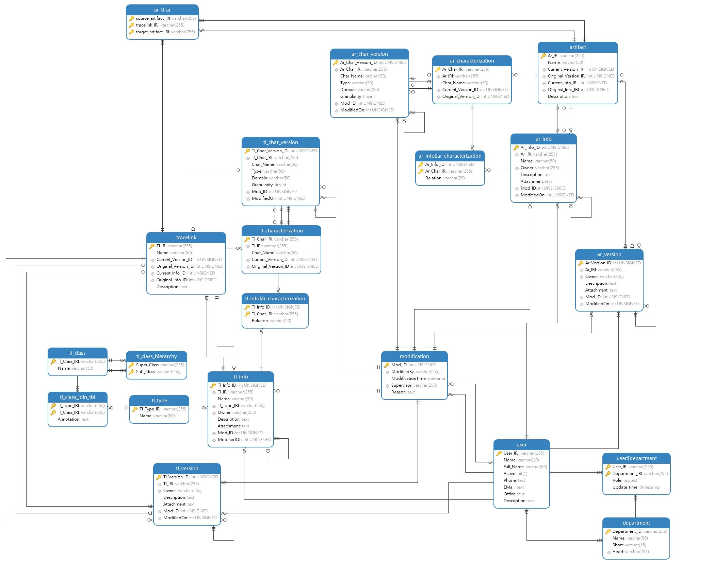
DB Overview

Slide 4


DB Overview
Trace Link
Artifact
Trace Link Ontology
User

Slide 5
DB Elements
Trace Link
Artifact
Trace Link & Artifact
Trace Link Ontology
The data describing the trace links and artifact in the system

Slide 6
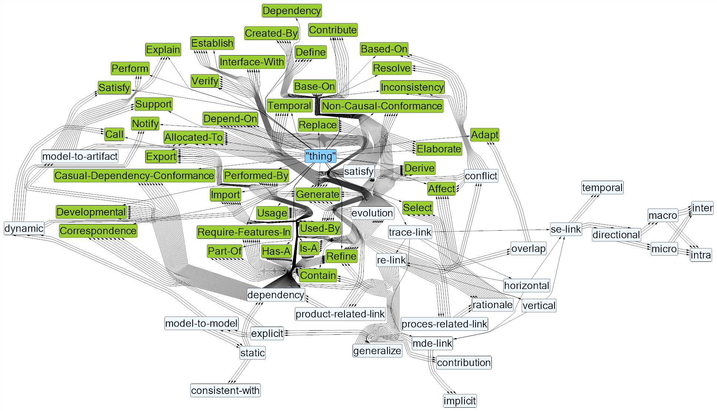
DB Elements
Trace Link Ontology
CNL Diagram of Trace Link Ontology

Slide 7

DB Elements
Name: Aaaaa Bbbbb (Bbbbb, A)
Department: XXXXXXXX
Role: Manager
Phone: ###########
Email: XXXXXX@XXXX.XXX
Office: ----------------------------
Description:
User

Slide 8
DB Features
Trace Link
Source Artifact
Target Artifact

Slide 9
DB Features
Trace Link
Source Artifact
Name
IRI
Type
Modification time
Owner
Characterization
..
Target Artifact
Name
IRI
Modification time
Owner
Characterization
..
Name
IRI
Modification time
Owner
Characterization
..

Slide 10
DB Features
Name: *********
Modified Time: YYYY-MM-DD
Modifier: XXXXX
Name: *********
Modified Time: YYYY-MM-DD
Modifier: XXXXX
Name: *********
Modified Time: YYYY-MM-DD
Modifier: XXXXX

Slide 11
Trace Link
Source Artifact
Name
IRI
Modification time
Owner
Characterization
..
Target Artifact
Name
IRI
Modification time
Owner
Characterization
..
Name
IRI
Modification time
Owner
Characterization
..
Name: *********
Modified Time: YYYY-MM-DD
Modifier: XXXXX
Name: *********
Modified Time: YYYY-MM-DD
Modifier: XXXXX
Name: *********
Modified Time: YYYY-MM-DD
Modifier: XXXXX

